Slide 1
Kevaro Athletics & Co. Membership Systemization Analysis
- A Data Analytics Case Study by Anik Chakraborty

Slide 2
🎯 Objective
To analyze the gender-wise representation and salary distribution across different sports and countries for Kevaro Athletics’ global selection pool. The goal is to identify patterns in participation diversity, pay disparity, and high-salary sports to support equitable athlete management and strategic talent investments.
Project Purpose:
Evaluate the sport-wise and country-wise candidate participation in the selection pool.
Compare total and average salaries between male and female athletes across sports.
Identify top-performing (high-salaried) sports and countries contributing maximum value.
Support Kevaro Athletics in designing data-driven gender equity and sponsorship strategies.
Key KPIs:
Total Candidates
Gender Distribution (Male vs Female)
Total Salary (USD) by Gender
Average Salary (USD) per Candidate
Sport-wise & Country-wise Salary Ranking
Deliverables:
Interactive Excel Dashboard visualizing:
Gender representation across sports and countries
Sport-wise salary contribution by gender
Top 5 highest-paid sports
Analytical summary highlighting disparities and trends
Action-oriented insights for management & sponsorship allocation

Slide 3
📘 Project Overview
Context Highlights:
Kevaro Athletics, a global sports organization, maintains a diverse selection pool of 50 athletes representing 11 countries and multiple sporting disciplines.
This project evaluates the balance and fairness of gender participation and salary distribution, reflecting organizational commitment toward inclusivity and performance-based equity.

Slide 4
🗂️ Data Overview & Schema
Data Source:
Source: Fictionalized Kevaro Athletics dataset (inspired by public sports/athletics datasets).
Data Type: Structured tabular dataset (athlete-level summary).
Time Period: One-time Snapshot of the latest global selection pool cycle (FY 2023–24).
Data Structure & Metrics:
Key Index Types: Athlete-level records (each row = 1 candidate). Total Rows: 50.
Categories:
Candidate Participation
Salary Distribution (in USD)
Country Representation
Gender-wise Salary Contribution
Calculated Metrics:
Total Candidates by Sport & Country
Gender Ratio (%)
Total & Average Salary (USD)
Salary Share (%) by Gender
Top Sports & Countries by Total Salary

Slide 5
💻 Tech Stack
Tools:
Microsoft Excel
Data cleaning & preprocessing
Pivot Tables for aggregation
Pivot Charts for visualizations
Slicers/filters for interactivity
Dashboard creation
PowerPoint
Presentation and final dashboard snapshots

Slide 6
📈 Methodology & Analysis
Prepare, Process & Analytical Approach:
Data Cleaning: Standardized missing values (e.g., gender blanks in Brazil).
Aggregation: Calculated total and gender-wise salaries across sports.
Segmentation: Categorized by Country and Sport for participation distribution.
Visualization: Created stacked column visuals for gender participation and salary contribution.
Comparison Metrics: Derived ratio of Male:Female salary and participation per sport.
Validation: Ensured total athlete count = 50, total salary balance validated.

Slide 7
❓ Problem Statement
Without consolidated insights, it becomes difficult to identify performance gaps or guide effectively.
Key Questions:
What is the overall gender representation in Kevaro’s global selection pool?
Which sports offer the highest total and average salaries?
Is there a significant gender pay gap across specific sports?
Which countries contribute the most athletes and salary volume?

Slide 8
💡 Key Insights
Top Findings:
Balanced Gender Participation: 25 Male & 25 Female athletes selected globally.
High-Salary Sports: Cycling Road, Volleyball, Alpine Skiing, and Triathlon show top salary aggregates.
Pay Disparity Exists: Males dominate higher-paying sports like Biathlon, Cycling Road, and Triathlon.
Female Salary Dominance: Notable in Volleyball, Equestrian, and Shooting, indicating strong female representation.
Country Representation: France, Australia, and USA lead in total candidates and salary share.
Supporting Metrics:
Highest Male Salary Sport: Cycling Road – $9.6M
Highest Female Salary Sport: Volleyball – $8.6M
Countries with maximum athletes: France (9), Australia (8), USA (7)

Slide 9
📍 Conclusion
Summary:
Kevaro Athletics demonstrates an encouraging gender balance in athlete participation but shows uneven salary distribution across disciplines.
While certain sports reflect female leadership in earnings, others maintain a significant male bias.
The data highlights the need for targeted parity initiatives, performance-linked pay reviews, and inclusive sponsorship strategies.

Slide 10
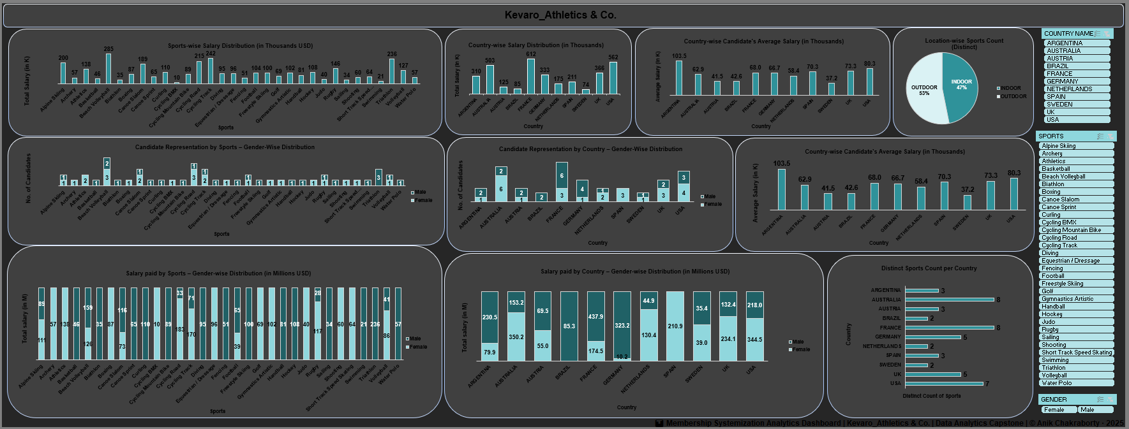
🖥️Dashboard Overview

Slide 11
✅ Business Impact & Use Cases
Supports gender equity reporting and compliance with global sports standards.
Enables salary budgeting and sponsorship alignment per sport and gender.
Empowers HR and management to identify underrepresented sports for development.
Forms basis for Kevaro’s Diversity & Inclusion dashboard in future athlete selection cycles.

Slide 12
🙏 Acknowledgement & Contact
Project Analyst: Anik Chakraborty 📧 Email: anikc1710@gmail.com
Special Thanks To:
Coding Ninjas – for project framework and guidance
Connect: 🔗 GitHub | 🔗 LinkedIn

Slide 13
Thank You!

